Slide 1

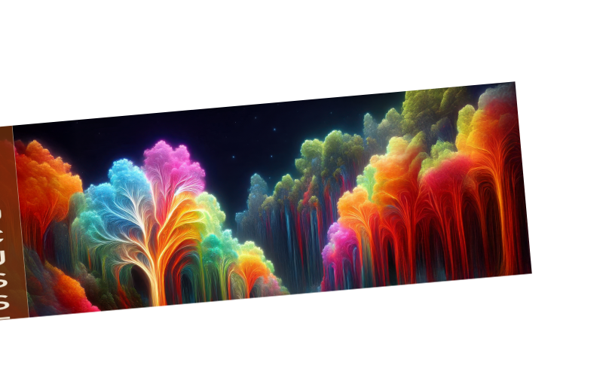
BIG
IMPACT
IDEA
Make Some Noise

Slide 2


THE NOISE
Everyone is shouting.
No one is listening.
In a saturated market, average doesn't just fail—it becomes invisible. The confusion is real.

Slide 3

CUT THROUGH
"We need clarity, not volume. A simple message travels further than a loud one."

Slide 4






OUR APPROACH
SIMPLIFY
AMPLIFY
ELECTRIFY
Cut the fat. Keep the muscle.
Turn up the volume on what matters.
Shock the system with bold visuals.

Slide 5


WHO IS IT FOR?
THE MODERN CREATOR
They are visually literate, attention-span challenged, and crave authenticity.
Digital Native
Trend Setter
Value Driven

Slide 6



BOLD FEATURES
High Contrast: Visuals that stop the scroll immediately.
Minimalist Copy: We say more with less words.
Emotional Hooks: Design that makes you feel something.

Slide 7


VISUAL LANGUAGE
Chunky shapes.
Vibrant colors.
No fluff.
Our identity is designed to be recognized instantly, even without a logo.

Slide 8
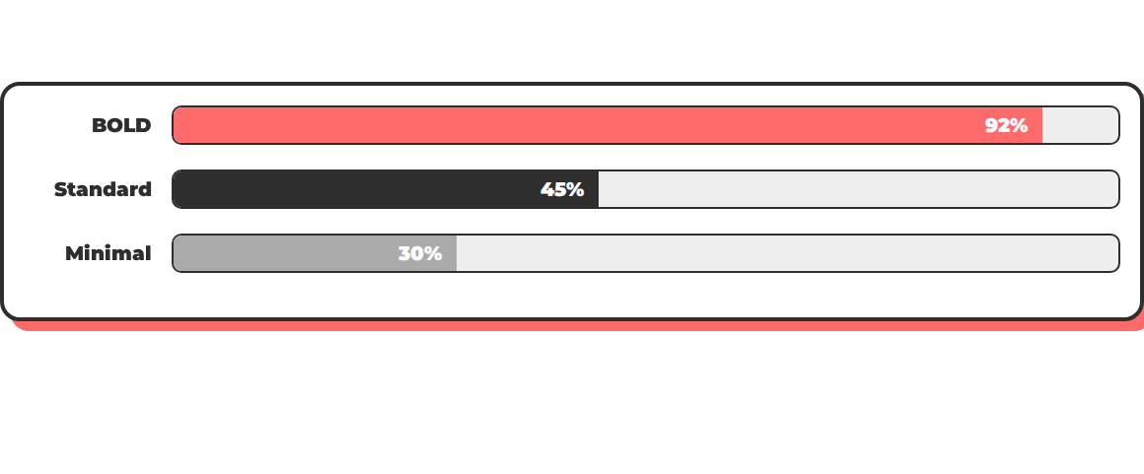
ENGAGEMENT STATS
Bold design yields 2x higher engagement.

Slide 9
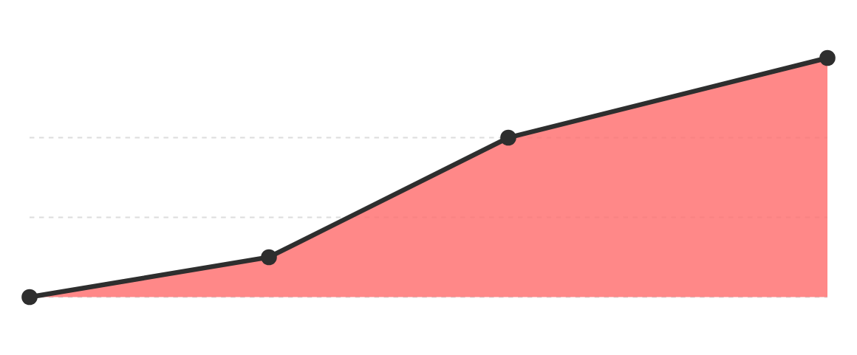
GROWTH TRAJECTORY

Slide 10

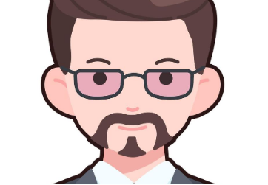

THE CREATIVES
DIRECTOR
TECH LEAD
STRATEGIST
Visionary
Architect
Planner

Slide 11




LAUNCH PLAN
Q1
Q2
Q3
Q4
Concept
Build
Launch
Scale

Slide 12




LET'S MAKE NOISE
hello@boldcreative.com

Slide 13






IMAGE SOURCES
http://unfocussed.com/cdn/shop/articles/Luminescent_Symphony.png?v=1732049525
Source: unfocussed.com
https://static.vecteezy.com/system/resources/previews/049/526/054/non_2x/speech-bubble-showing-tangled-lines-representing-confused-thoughts-vector.jpg
Source: www.vecteezy.com
https://static.vecteezy.com/system/resources/previews/059/308/353/non_2x/minimalist-couple-illustration-flat-design-pink-background-black-and-red-color-scheme-simple-cartoon-style-vector.jpg
Source: www.vecteezy.com
https://render.fineartamerica.com/images/rendered/default/print/8/6/break/images/artworkimages/medium/3/color-study-squares-with-concentric-circles-by-wassily-kandinsky-orca-art-gallery.jpg
Source: orca-artgallery.pixels.com
https://img.freepik.com/premium-vector/short-hair-woman-flat-avatar-vector_463875-147.jpg
Source: www.freepik.com
https://static.vecteezy.com/system/resources/previews/019/494/610/non_2x/business-man-boy-avatar-user-person-people-beard-glasses-flat-sticker-black-style-vector.jpg
Source: www.vecteezy.com

Slide 14

IMAGE SOURCES
https://img.freepik.com/premium-vector/call-center-operator-avatar-with-headphone-online-support-service-assistant-male-customer-help-manager-vector-illustration-character_87946-6445.jpg
Source: www.freepik.com

